Slide 1
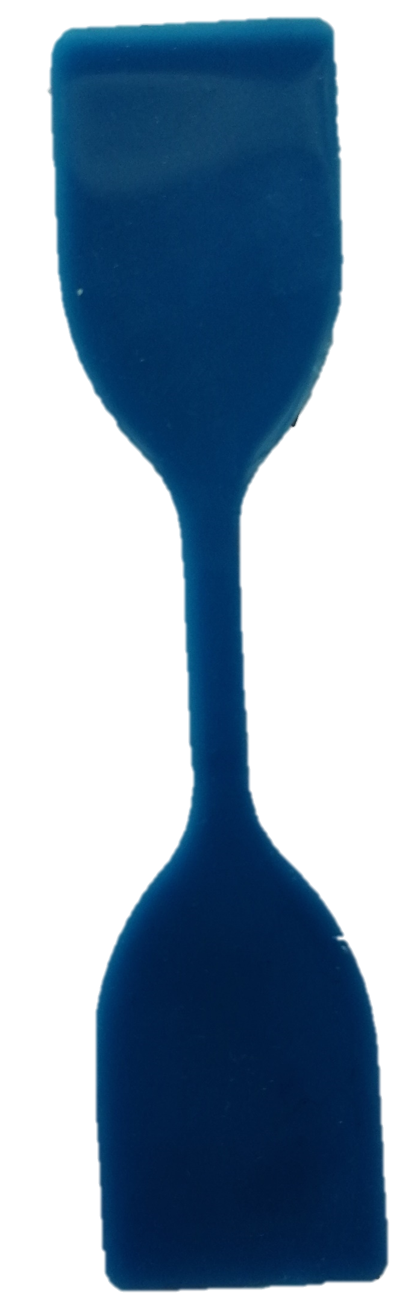
25mm
20mm
110mm

Slide 2
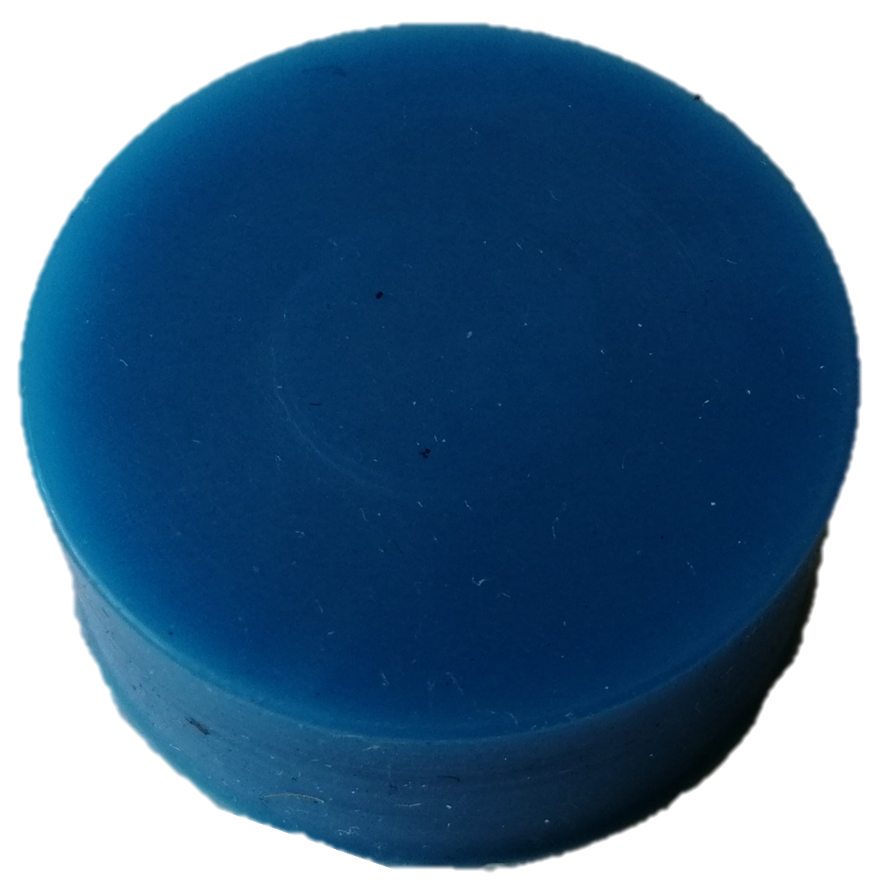
ø30mm

